Slide 1
Neuromuscular Monitoring
Moderator : DR.ANUP N R
Presentor : DR.DINESH

Slide 2
Introduction
Neuromuscular monitoring is based on two important issues:
1. on the variable response to muscle relaxants and
2 because of the narrow therapeutic window.
There is no detectable block until 75 to 85% of receptors are occupied and paralysis is complete at 90 to 95% receptor occupancy.
Neuromuscular monitoring permit optimal surgical relaxation and reverses the block spontaneously or revesed quickly with antagonists.

Slide 3
Residual neuromuscular block is a major risk factor for many critical events in the immediate postoperative period such as ventilatory insufficiency, hypoxemia and pulmonary infections.
In Awake patients, muscle power can be evaluated through tests of voluntary muscle strength
During anesthesia and recovery from anesthesia this is not possible. Instead, the clinician uses clinical tests to assess muscle power directly and to estimate neuromuscular function indirectly (muscle tone, the feel of the anesthesia bag, an indirect measure of pulmonary compliance, tidal volume, and inspiratory force).

Slide 4
Features of Neurostimulation
Key features of exogenous nerve stimulation are:
Nerve stimulator: A battery powered device that delivers depolarizing current via the electrodes.
Pulse width: Is the duration of the individual impulse delivered by the nerve stimulator.
Each impulse should be <0.5msec and 0.1sec in duration to elicit nerve firing at a readily attainable current. Pulse width >0.5msec extends beyond the refractory period of the nerve resulting in repetitive firing.

Slide 5
Current intensity: Is the amperage(mA) of the current delivered by the nerve stimulator. The current output of most stimulators can range from 0-80mA.
Supramaximal current: Is approximately 10-20% higher intensity than the current required to depolarize all fibres in a particular nerve bundles.

Slide 6
Submaximal current: A current intensity that induces firing of only a fraction fibres in a given nerve bundle and is less painful
Stimulus frequency: The rate (Hz) at which each impulse is repeated in cycles per second (Hz).
Single twitch is commonly repeated at 10 second intervals i.e. 0.1 Hz and
Tetanic stimulation commonly consists of 50 impulses/ sec i.e. 50 Hz.

Slide 7
ELECTRODES
Surface Electrodes: They contain gel conducting surfaces for transmission of impulses to the nerves through the skin. With careful skin preparation the threshold for which response is generally <15mA.
Needle Electrodes: Subcutaneous needles deliver the impulse in the immediate vicinity of the nerve. These are highly effective because they bypass the tissue impedance so that the tissue impedance is typically <2000 Ohms.

Slide 8
Types of Peripheral Nerve Stimulation
Neuromuscular function is monitored by evaluating the muscular response to supramaximal stimulation of a peripheral motor nerve.
Two types of stimulation can be used: electrical and magnetic.
Magnetic nerve stimulation has several advantages over electrical nerve stimulation. It is less painful and does not require physical contact with the body.
However, the equipment required is bulky and heavy, it cannot be used for train-of-four (TOF) stimulation, and it is difficult to achieve supramaximal stimulation with this method.

Slide 9
Principles of Peripheral Nerve Stimulation
The reaction of a single muscle fiber to a stimulus follows an all-or-none pattern.
In contrast, the response of the whole muscle depends on the number of muscle fibers activated.
The stimulus must be truly maximal throughout the period of monitoring; therefore, the electrical stimulus applied is usually at least 20% to 25% above that necessary for a maximal response. For this reason the stimulus is said to be supramaximal.

Slide 10
Patterns of Nerve Stimulation
Single-twitch
TOF
Tetanic
Post-tetanic count (PTC)
Double-burst stimulation (DBS).

Slide 11
Single-Twitch Stimulation
A Single supramaximal electrical stimuli are applied to a peripheral motor nerve at frequencies ranging from 1.0 Hz (once every second) to 0.1 Hz (once every 10 seconds) .
The response to single-twitch stimulation depends on the frequency at which the individual stimuli are applied.
Because 1-Hz stimulation shortens the time necessary to determine supramaximal stimulation, this frequency is sometimes used during induction of anesthesia.

Slide 12
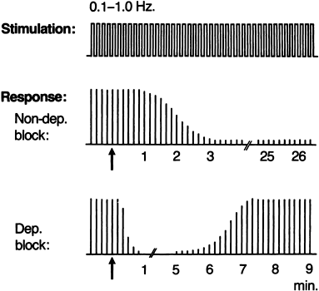

Slide 13
Train-of-Four Stimulation
First described by Ali et al.
Four supramaximal stimuli are given every 0.5 second (2 Hz).
When used continuously, each set (train) of stimuli is normally repeated every 10th to 20th second.
Each stimulus in the train causes the muscle to contract, and “fade” in the response provides the basis for evaluation.
That is, dividing the amplitude of the fourth response by the amplitude of the first response provides the TOF ratio.
In the control response (the response obtained before the administration of a muscle relaxant), all four responses are ideally the same: the TOF ratio is 1.0.

Slide 14
During a partial nondepolarizing block, the ratio decreases (fades) and is inversely proportional to the degree of blockade.
During a partial depolarizing block, no fade occurs in the TOF response; ideally, the TOF ratio is approximately 1.0.
Fade in the TOF response after injection of succinylcholine signifies the development of a phase II block.
The advantages of TOF stimulation are greatest during nondepolarizing blockade because the degree of block can be read directly from the TOF response even though a preoperative value is lacking.
In addition, TOF stimulation has some advantages over tetanic stimulation: it is less painful and, unlike tetanic stimulation, does not generally affect the degree of neuromuscular blockade.

Slide 15
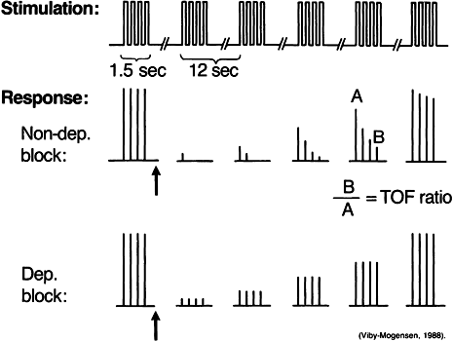

Slide 16
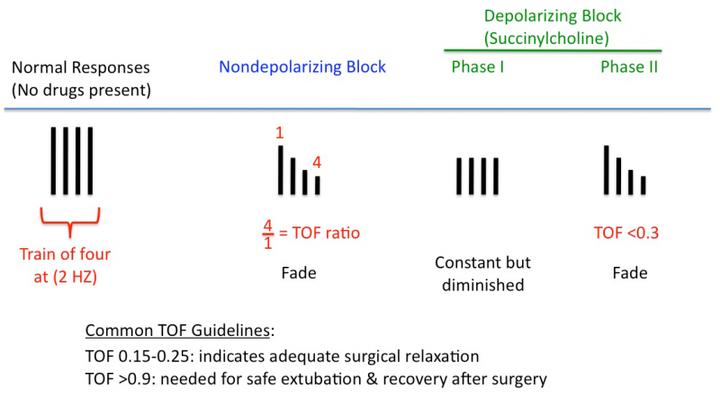

Slide 17
Tetanic Stimulation
Tetanic stimulation consists of very rapid (e.g., 30-, 50-, or 100-Hz) delivery of electrical stimuli.
The most commonly used pattern in clinical practice is 50-Hz stimulation given for 5 seconds, although some investigators have advocated the use of 50-, 100-, and even 200-Hz stimulation for 1 second.
During normal neuromuscular transmission and a pure depolarizing block, the muscle response to 50-Hz tetanic stimulation for 5 seconds is sustained.

Slide 18
During a nondepolarizing block and a phase II block after the injection of succinylcholine, the response will not be sustained (i.e., fade occurs)
Fade in response to tetanic stimulation is normally considered a presynaptic event; the traditional explanation is that at the start of tetanic stimulation, large amounts of acetylcholine are released from immediately available stores in the nerve terminal.
As these stores become depleted, the rate of acetylcholine release decreases until equilibrium between mobilization and synthesis of acetylcholine is achieved.

Slide 19
When the “margin of safety” at the postsynaptic membrane (i.e., the number of free cholinergic receptors) is reduced by nondepolarizing neuromuscular blocking drugs, a typical reduction in twitch height is seen with a fade during, for instance, repetitive stimulation.
In addition to this postsynaptic block, nondepolarizing neuromuscular blocking drugs may also block presynaptic neuronal-type acetylcholine receptors, thereby leading to impaired mobilization of acetylcholine within the nerve terminal.
This effect substantially contributes to fade in the response to tetanic (and TOF) stimulation.

Slide 20
Although the degree of fade depends primarily on the degree of neuromuscular blockade, fade also depends on the frequency (Hz) and the length (seconds) of stimulation and on how often tetanic stimuli are applied.
During partial nondepolarizing blockade, tetanic nerve stimulation is followed by a post-tetanic increase in twitch tension (i.e., post-tetanic facilitation of transmission).
This event occurs because the increase in mobilization and synthesis of acetylcholine caused by tetanic stimulation continues for some time after discontinuation of stimulation.

Slide 21
The degree and duration of post-tetanic facilitation depend on the degree of neuromuscular blockade, with post-tetanic facilitation usually disappearing within 60 seconds of tetanic stimulation.
In contrast, post-tetanic twitch potentiation, which sometimes occurs in mechanical recordings before any neuromuscular blocking drug has been given, is a muscular phenomenon that is not accompanied by an increase in the compound muscle action potential.
Tetanic stimulation is very painful and therefore not normally acceptable to an unanesthetized patient.

Slide 22
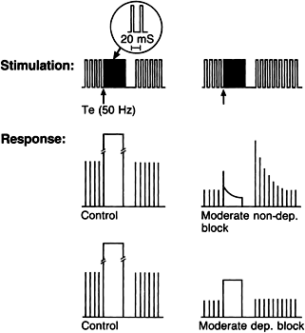

Slide 23
Post-Tetanic Count Stimulation
Injection of a nondepolarizing neuromuscular blocking drug in a dose sufficient to ensure smooth tracheal intubation causes intense neuromuscular blockade of the peripheral muscles.
Because no response to TOF and single-twitch stimulation occurs under these conditions, these modes of stimulation cannot be used to determine the degree of blockade.
It is possible, however, to quantify intense neuromuscular blockade of the peripheral muscles by applying tetanic stimulation (50 Hz for 5 seconds) and observing the post-tetanic response to single-twitch stimulation given at 1 Hz starting 3 seconds after the end of tetanic stimulation.
During intense blockade, there is no response to either tetanic or post-tetanic stimulation.

Slide 24
As the intense block dissipates, more and more responses to post-tetanic twitch stimulation appear. For a given neuromuscular blocking drug, the time until return of the first response to TOF stimulation is related to the number of post-tetanic twitch responses present at a given time (i.e., the PTC)
The PTC method is mainly used to assess the degree of neuromuscular blockade when there is no reaction to single-twitch or TOF nerve stimulation, as may be the case after injection of a large dose of a nondepolarizing neuromuscular blocking drug.
However, PTC can also be used whenever sudden movements must be eliminated (e.g., during ophthalmic surgery).

Slide 25
The necessary level of blockade of the adductor pollicis muscle to ensure paralysis of the diaphragm depends on the type of anesthesia and, in the intensive care unit, on the level of sedation.
To ensure elimination of any bucking or coughing in response to tracheobronchial stimulation, neuromuscular blockade of the peripheral muscles must be so intense that no response to post-tetanic twitch stimulation can be elicited (PTC 0)
The response to PTC stimulation depends primarily on the degree of neuromuscular blockade.

Slide 26
It also depends on the :-
frequency and duration of tetanic stimulation,
the length of time between the end of tetanic stimulation and the first post-tetanic stimulus,
the frequency of the single-twitch stimulation,
the duration of single-twitch stimulation before tetanic stimulation.
When the PTC method is used, these variables should be kept constant.
In addition, because of possible antagonism of neuromuscular blockade in the hand, tetanic stimulation should not be performed more often than every 6 minutes.

Slide 27
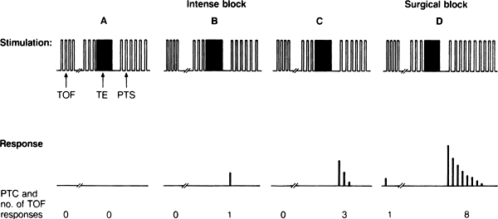
Pattern of electrical stimulation and evoked muscle responses to
train-of-four (TOF) nerve stimulation,
50-Hz tetanic nerve stimulation for 5 seconds (TE), and
1.0-Hz post-tetanic twitch stimulation (PTS) during four different levels of nondepolarizing neuromuscular blockade.
[A] During intense blockade of peripheral muscles no response to any of the forms of stimulation occurs.
[B/ C] During less pronounced blockade, there is still no response to TOF stimulation, but post-tetanic facilitation of transmission is present.
[D] During surgical blockade , the first response to TOF appears and post-tetanic facilitation increases further.
The post-tetanic count is 1 during very deep block (B), 3 during less deep block (C), and 8 during surgical (or moderate) block (D).

Slide 28
Double-Burst Stimulation
DBS consists of two short bursts of 50-Hz tetanic stimulation separated by 750 msec.
The duration of each square wave impulse in the burst is 0.2 msec.
Although the number of impulses in each burst can vary, DBS with three impulses in each of the two tetanic bursts (DBS_{3,3}) is most commonly used.

Slide 29
In nonparalyzed muscle, the response to DBS_{3,3} is two short muscle contractions of equal strength.
In a partly paralyzed muscle, the second response is weaker than the first (i.e., the response fades).
DBS was developed with the specific aim of allowing manual (tactile) detection of small amounts of residual blockade under clinical conditions,and during recovery and immediately after surgery, tactile evaluation of the response to DBS_{3,3} is superior to tactile evaluation of the response to TOF stimulation.

Slide 30
The Nerve Stimulator
The stimulus should produce a monophasic and rectangular waveform, and the length of the pulse should not exceed 0.2 to 0.3 msec.
A pulse exceeding 0.5 msec may stimulate the muscle directly or cause repetitive firing.
Stimulation at a constant current is preferable to stimulation at a constant voltage because current is the determinant of nerve stimulation.
Furthermore, for safety reasons, the nerve stimulator should be battery operated, include a battery check, and be able to generate 60 to 70 mA, but not higher than 80 mA.
Many commercially available stimulators can deliver just 25 to 50 mA and provide a constant current only when skin resistance ranges from 0 to 2.5 kΩ.

Slide 31
The ideal nerve stimulator should have other features as well:
The polarity of the electrodes should be indicated, and the apparatus should be capable of delivering the following modes of stimulation: TOF (as both a single train and in a repetitive mode, with TOF stimulation being given every 10 to 20 seconds), single-twitch stimulation at 0.1 and 1.0 Hz, and tetanic stimulation at 50 Hz.
In addition, the stimulator should have a built-in time constant system to facilitate PTC.
If the nerve stimulator does not allow objective measurement of the response to TOF stimulation, at least one DBS mode should be available, preferably DBS_{3,3}.

Slide 32
The Stimulating Electrodes
Electrical impulses are transmitted from stimulator to nerve by means of surface or needle electrodes, the former being the more commonly used in clinical anesthesia.
Normally, disposable pregelled silver or silver chloride surface electrodes are used. The actual conducting area should be small, approximately 7 to 11 mm in diameter

Slide 33
The skin should always be cleansed properly and preferably rubbed with an abrasive before application of the electrodes.
When a supramaximal response cannot be obtained with surface electrodes, needle electrodes should be used.
Although specially coated needle electrodes are commercially available, ordinary steel injection needles can be used.
The needles should be placed subcutaneously but never in a nerve.

Slide 34
Sites of Nerve Stimulation
In principle, any superficially located peripheral motor nerve may be stimulated.
In clinical anesthesia, the ulnar nerve is the most popular site.
The median, posterior tibial, common peroneal, and facial nerves are also sometimes used.
For stimulation of the ulnar nerve, the electrodes are best applied to the volar side of the wrist

Slide 35
The distal electrode should be placed about 1 cm proximal to the point at which the proximal flexion crease of the wrist crosses the radial side of the tendon to the flexor carpi ulnaris muscle.
The proximal electrode should preferably be placed so that the distance between the centers of the two electrodes is 3 to 6 cm .
With this placement of the electrodes, electrical stimulation normally elicits only finger flexion and thumb adduction.
If one electrode is placed over the ulnar groove at the elbow, thumb adduction is often pronounced because of stimulation of the flexor carpi ulnaris muscle.

Slide 36
When this latter placement of electrodes (sometimes preferred in small children) is used, the active negative electrode should be at the wrist to ensure maximal response.
Polarity of the electrodes is less crucial when both electrodes are close to each other at the volar side of the wrist; however, placement of the negative electrode distally normally elicits the greatest neuromuscular response.
When the temporal branch of the facial nerve is stimulated, the negative electrode should be placed over the nerve, and the positive electrode should be placed somewhere else over the forehead.

Slide 37
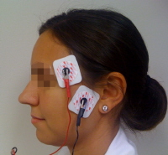
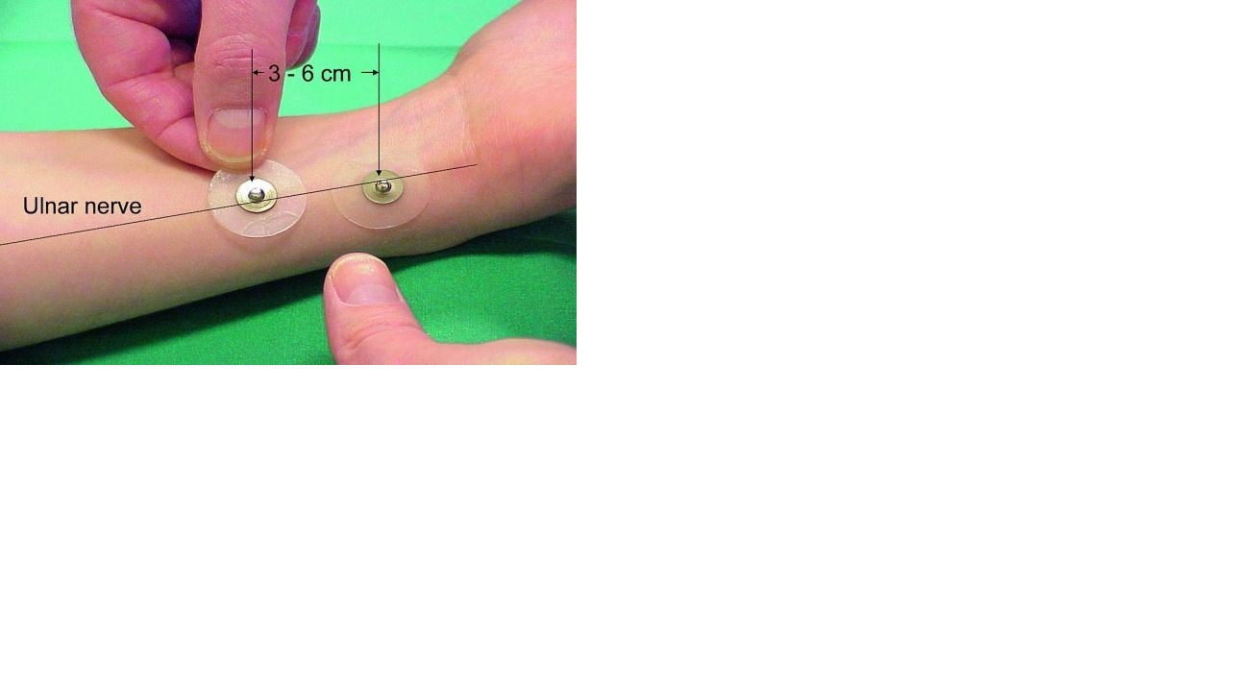

Slide 38
The diaphragm is among the most resistant of all muscles to both depolarizing and nondepolarizing neuromuscular blocking drugs.
In general, the diaphragm requires 1.4 to 2.0 times as much muscle relaxant as the adductor pollicis muscle for an identical degree of blockade .
Also of clinical significance is that onset time is normally shorter for the diaphragm than for the adductor pollicis muscle and the diaphragm recovers from paralysis more quickly than the peripheral muscles do .
The other respiratory muscles are less resistant than the diaphragm, as are the larynx and the corrugator supercilii muscles.

Slide 39
Most sensitive are the abdominal muscles, the orbicularis oculi muscle, the peripheral muscles of the limbs, and the geniohyoid, masseter, and upper airway muscles.
From a practical clinical point of view, it is worth noting that (1) the response of the corrugator supercilii to facial nerve stimulation reflects the extent of neuromuscular blockade of the laryngeal adductor muscles and abdominal muscles better than the response of the adductor pollicis to ulnar nerve stimulation does .
(2) the upper airway muscles seem to be more sensitive than the peripheral muscles.

Slide 40
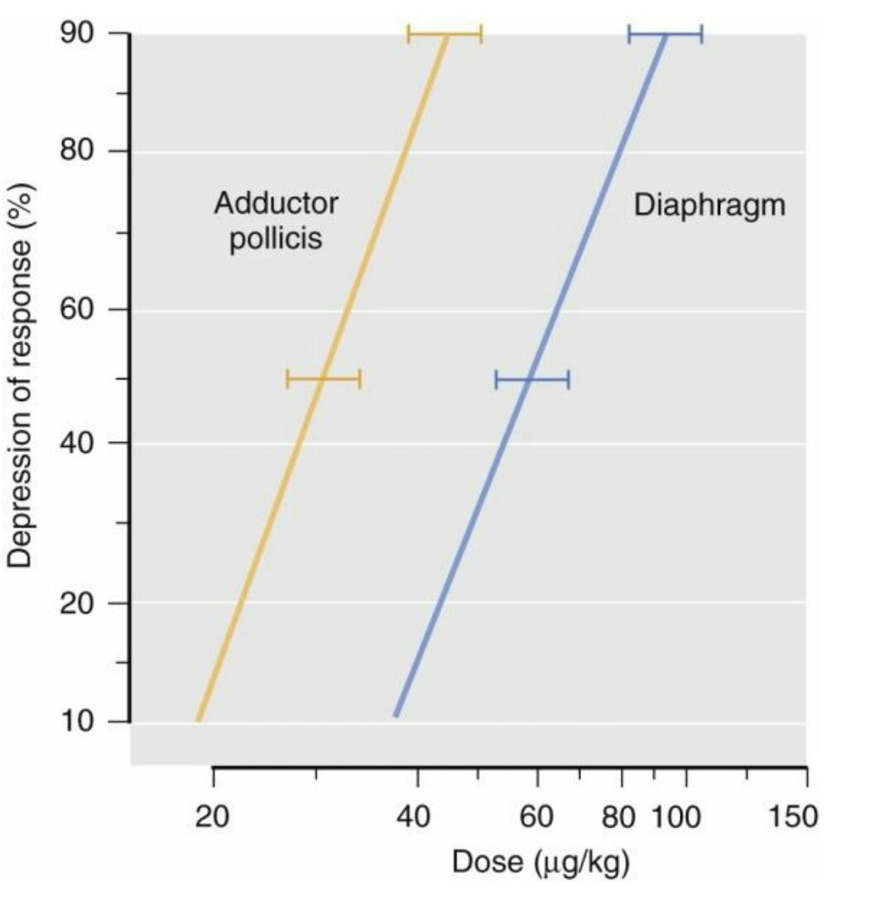
The mean cumulative dose-response curve for pancuronium in two muscles shows that the diaphragm requires approximately twice as much pancuronium as the adductor pollicis muscle for the same amount of neuromuscular blockade.
The depression in muscle response to the first stimulus in train-of-four nerve stimulation (probit scale) was plotted against dose (log scale).
The force of contraction of the adductor pollicis was measured on a force-displacement transducer; response of the diaphragm was measured electromyographically.

Slide 41
Even though the precise source of these differences is unknown, variations in
Acetylcholine receptor density,
Acetylcholine release,
Acetylcholinesterase activity,
Fiber composition,
Innervation ratio (number of neuromuscular junctions),
Blood flow, and
Muscle temperature may be possible explanations.
In assessing neuromuscular function, use of a relatively sensitive muscle such as the adductor pollicis of the hand has both disadvantages and advantages.

Slide 42
Obviously, during surgery it is a disadvantage that even total elimination of the response to single-twitch and TOF stimulation does not exclude the possibility of movement of the diaphragm, such as hiccupping and coughing.
PTC stimulation, however, allows evaluation of the intense blockade necessary to ensure total paralysis of the diaphragm.
On the positive side, the risk of overdosing the patient decreases if the response of a relatively sensitive muscle is used as a guide to the administration of muscle relaxants during surgery.
In addition, during recovery, when the adductor pollicis has recovered sufficiently, it can be assumed that no residual neuromuscular blockade exists in the diaphragm or in other resistant muscles.

Slide 43
Recording of Evoked Responses
Five methods are available:
Measurement of the evoked mechanical response of the muscle (mechanomyography [MMG]),
Measurement of the evoked electrical response of the muscle (electromyography [EMG]),
Measurement of acceleration of the muscle response (acceleromyography [AMG]),
Measurement of the evoked electrical response in a piezoelectric film sensor attached to the muscle (piezoelectric neuromuscular monitor [P_{Z}EMG]
Phonomyography [PMG]).

Slide 45
Mechanomyography
The mechanomyogram (MMG) is the mechanical signal observable from the surface of a muscle when the muscle is contracted.
At the onset of muscle contraction, gross changes in the muscle shape cause a large peak in the MMG.
Subsequent vibrations are due to oscillations of the muscle fibres at the resonance frequency of the muscle.
A requirement for correct and reproducible measurement of evoked tension is that the muscle contraction be isometric.
In clinical anesthesia, this condition is most easily achieved by measuring thumb movement after the application of a resting tension of 200 to 300 g (a preload) to the thumb.
When the ulnar nerve is stimulated, the thumb (the adductor pollicis muscle) acts on a force-displacement transducer.

Slide 46
The force of contraction is then converted into an electrical signal, which is amplified, displayed, and recorded.
The arm and hand should be rigidly fixed, and care should be taken to prevent overloading of the transducer.
In addition, the transducer should be placed in correct relation to the thumb (i.e., the thumb should always apply tension precisely along the length of the transducer).
It is important to remember that the response to nerve stimulation depends on the frequency with which the individual stimuli are applied and that the time used to achieve a stable control response may influence subsequent determination of the onset time and duration of blockade.
Generally, the reaction to supramaximal stimulation increases during the first 8 to 12 minutes after commencement of the stimulation.

Slide 48
Electromyography
(EMG) is a technique for evaluating and recording the electrical activity produced by skeletal muscles.
Evoked EMG records the compound action potentials produced by stimulation of a peripheral nerve. The compound action potential is a high-speed event that for many years could be picked up only by means of a preamplifier and a storage oscilloscope.

Slide 49
The evoked EMG response is most often obtained from muscles innervated by the ulnar or the median nerves.
Most often, the evoked EMG response is obtained from the thenar or hypothenar eminence of the hand or from the first dorsal interosseous muscle of the hand, preferably with the active electrode over the motor point of the muscle .
The signal picked up by the analyzer is processed by an amplifier, a rectifier, and an electronic integrator. The results are displayed either as a percentage of control or as a TOF ratio.

Slide 50
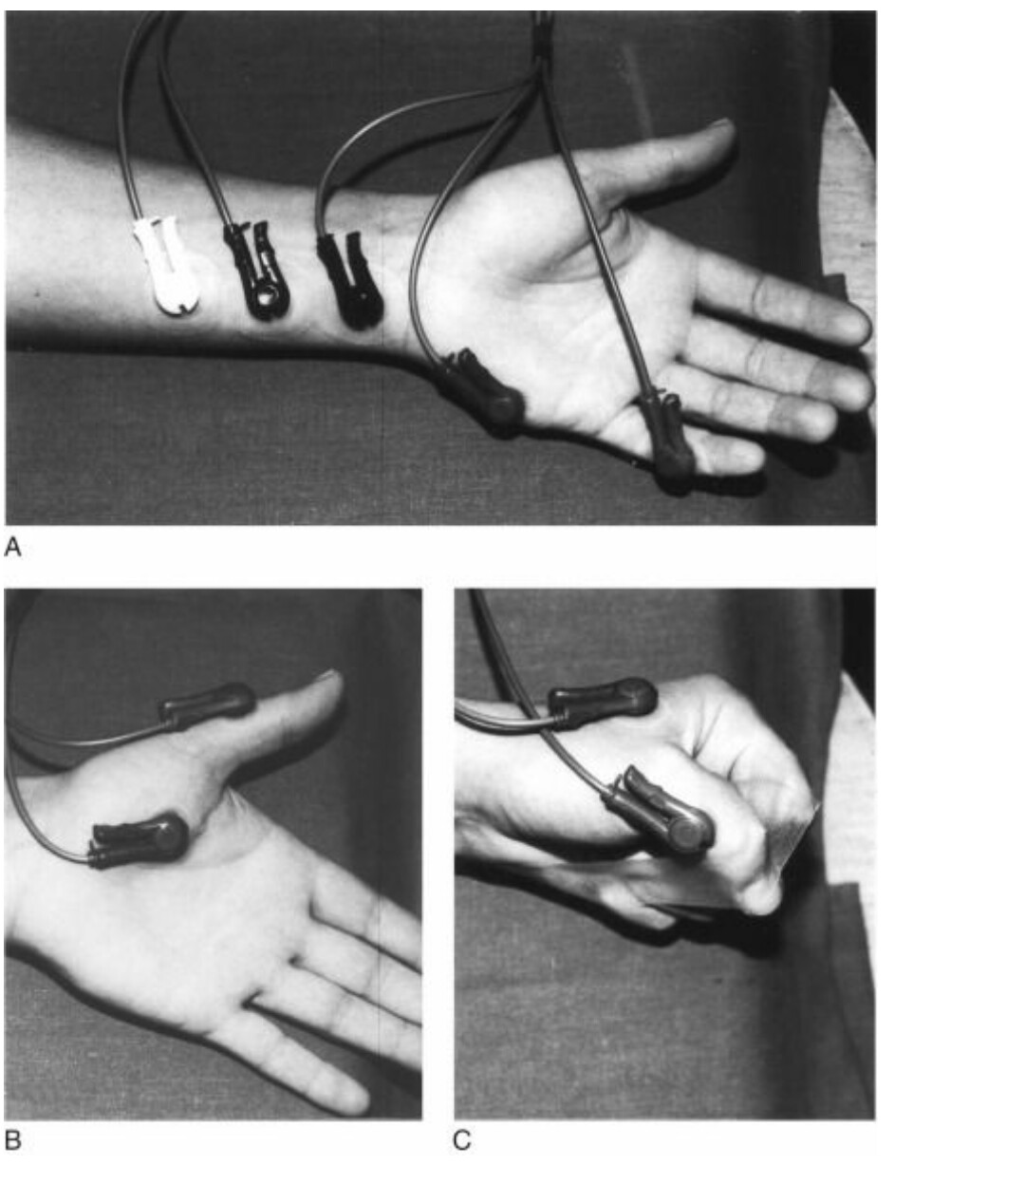
Electrode placement for stimulation of the ulnar nerve and for recording of the compound action potential from three sites of the hand.
A, Abductor digiti minimi muscle (in the hypothenar eminence).
B, Adductor pollicis muscle (in the thenar eminence).
C, First dorsal interosseus muscle.

Slide 51
Two new sites for recording the EMG response have been introduced: the larynx and the diaphragm.
By using a noninvasive disposable laryngeal electrode attached to the tracheal tube and placed between the vocal cords, it is possible to monitor the onset of neuromuscular blockade in the laryngeal muscles.
In paravertebral surface diaphragmatic EMG, the recording electrodes are placed on the right of vertebrae T12/L1 or L1/L2 for monitoring the response of the right diaphragmatic crux to transcutaneous stimulation of the right phrenic nerve at the neck.
Evoked electrical and mechanical responses represent different physiologic events. Evoked EMG records changes in the electrical activity of one or more muscles, whereas evoked MMG records changes associated with excitation-contraction coupling and contraction of the muscle as well.

Slide 53
Acceleromyograph
Is a piezoelectric myograph, used to measure the force produced by a muscle after it has undergone nerve stimulation.
Acceleromyographs measure muscle activity using a miniature piezoelectric transducer that is attached to the stimulated muscle.
A voltage is created when the muscle accelerates and that acceleration is proportion to force of contraction.
Acceleromyographs are more costly than the more common twitch monitors, but have been shown to better alleviate residual blockade and associated symptoms of muscle weakness, and to improve overall quality of recovery.

Slide 54
When an accelerometer is fixed to the thumb and the ulnar nerve is stimulated, an electrical signal is produced whenever the thumb moves.
This signal can be analyzed in a specially designed analyzer.
Transducer is fastened to the thumb and the stimulating electrodes.

Slide 55
When AMG is used with a free-moving thumb, as originally suggested,wide limits of agreements in twitch height (T1) and TOF ratio and differences in the onset and recovery course of blockade between AMG and MMG have been found.
Moreover, the AMG control TOF ratio is consistently higher than when measured with a force-displacement transducer.
In accordance with this, several studies have indicated that when using AMG, the TOF ratio indicative of sufficient postoperative neuromuscular recovery is 1.0 rather than 0.9 as when measured by MMG or EMG in the adductor pollicis muscle.

Slide 56
Originally claimed advantages of the method, that fixation of the hand could be reduced to a minimum as long as the thumb could move freely.
In daily clinical practice it is often not possible to ensure that the thumb can move freely and that the position of the hand does not change during a surgical procedure.
The evoked response may therefore vary considerably.
Several solutions have been proposed, and on-going clinical research indicates that the use of an elastic preload on the thumb may improve the agreement between results obtained with AMG and MMG.

Slide 57
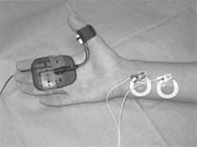
Hand adaptor (elastic preload) for the TOF-Watch transducer

Slide 58
When the thumb is not available for monitoring during surgery, some clinicians prefer to monitor the AMG response of the orbicularis oculi or the corrugator supercilii in response to facial nerve stimulation.
However, neuromuscular monitoring of both these sites with AMG is subject to large uncertainty regarding the extent of paralysis, and it therefore cannot be recommended for routine monitoring.
It provides only a rough estimate of the degree of block of the peripheral muscles.

Slide 59
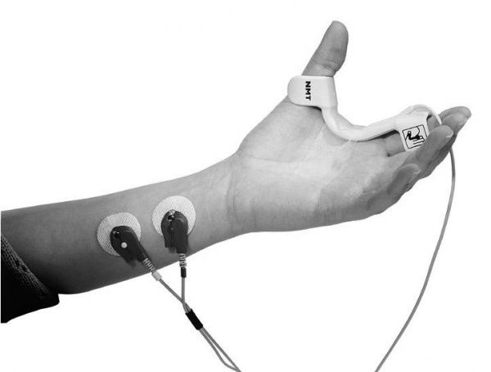
Piezoelectric Neuromuscular Monitors
The technique of the piezoelectric monitor is based on the principle that stretching or bending a flexible piezoelectric film (e.g., one attached to the thumb) in response to nerve stimulation generates a voltage that is proportional to the amount of stretching or bending.

Slide 60
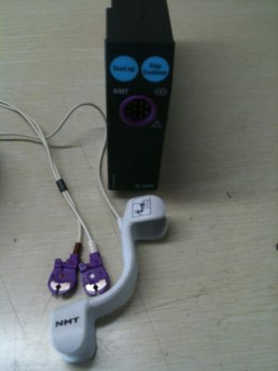
At least two devices based on this principle are available commercially: the ParaGraph Neuromuscular Blockade Monitor and the M-NMT MechanoSensor, which is a part of the Datex AS/3 monitoring system (Datex-Ohmeda, Helsinki, Finland)

Slide 61
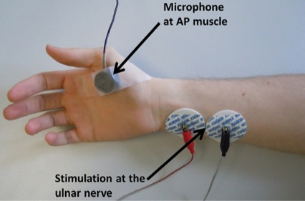
Phonomyography
Contraction of skeletal muscles generates intrinsic low-frequency sounds, which can be recorded with special microphones.
What does make PMG interesting, however, is that in theory the method can be applied not only to the adductor pollicis muscle but also to other muscles of interest such as the diaphragm, larynx, and eye muscles.
In addition, the ease of application is attractive.

Slide 62
Evaluation of Recorded Evoked Responses
Nerve stimulation in clinical anesthesia is usually synonymous with TOF nerve stimulation.
Therefore, the recorded response to this form of stimulation is used to explain how to evaluate the degree of neuromuscular blockade during clinical anesthesia.

Slide 63
Nondepolarizing Neuromuscular Blockade
After injection of a nondepolarizing neuromuscular blocking drug in a dose sufficient for smooth tracheal intubation, TOF recording demonstrates four phases or levels of neuromuscular blockade:
Intense blockade,
Deep blockade,
Moderate or surgical blockade,
Recovery

Slide 64
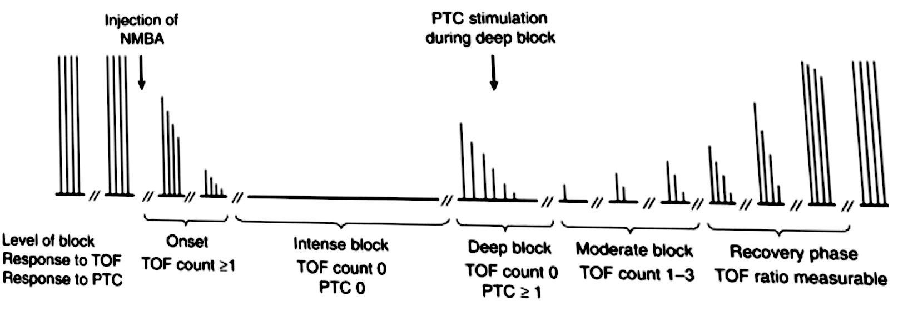
Levels of block after a normal intubating dose of a nondepolarizing neuromuscular blocking agent (NMBA) as classified by post-tetanic count (PTC) and train-of-four (TOF) stimulation.
During intense (profound) block, there are no responses to either TOF or PTC stimulation.
During Deep block, there is response to PTC but not to TOF stimulation.
Intense (profound) block and deep block together constitute the “period of no response to TOF stimulation.”
Reappearance of the response to TOF stimulation heralds the start of moderate block.
Finally, when all four responses to TOF stimulation are present and a TOF ratio can be measured, the recovery period has started.

Slide 65
Intense Neuromuscular Blockade
Intense neuromuscular blockade occurs within 3 to 6 minutes of injection of an intubating dose of a nondepolarizing muscle relaxant, depending on the drug and the dose given.
This phase is also called the “period of no response” because no response to any pattern of nerve stimulation occurs.
The length of this period varies, again depending primarily on the duration of action of the muscle relaxant and the dose given.
The sensitivity of the patient to the drug also affects the period of no response

Slide 66
Deep Neuromuscular Blockade
Characterized by absence of response to TOF stimulation, but presence of post-tetanic twitches (i.e., PTC ≥ 1)
Although it is not possible during this phase to determine exactly how long deep neuromuscular blockade will last, correlation does exist between PTC stimulation and the time until reappearance of the first response to TOF stimulation.

Slide 67
Moderate or Surgical Blockade
Moderate or surgical blockade begins when the first response to TOF stimulation appears.
This phase is characterized by a gradual return of the four responses to TOF stimulation.
When only one response is detectable, the degree of neuromuscular blockade (the depression in twitch tension) is 90% to 95%.
When the fourth response reappears, neuromuscular blockade is usually 60% to 85%.

Slide 68
The presence of one or two responses in the TOF pattern normally indicates sufficient relaxation for most surgical procedures.
During light anesthesia, however, patients may move, buck, or cough. Therefore, when elimination of sudden movements is crucial, a deeper block (or a deeper level of anesthesia) may be necessary. The deep block can then be evaluated by PTC.
Antagonism of neuromuscular blockade with a cholinesterase inhibitor should not normally be attempted when the blockade is intense or deep because reversal will often be inadequate, regardless of the dose of antagonist administered.
In general, antagonism with cholinesterase inhibitors should not be initiated before at least two and preferably three or four responses are observed.

Slide 69
Recovery
Return of the fourth response in the TOF heralds the recovery phase.
During neuromuscular recovery, a reasonably good correlation exists between the actual TOF ratio measured by MMG and clinical observation.

Slide 70
When the TOF ratio is 0.4 or less, the patient is generally unable to lift the head or arm. Tidal volume may be normal, but vital capacity and inspiratory force will be reduced.
When the ratio is 0.6, most patients are able to lift their head for 3 seconds, open their eyes widely, and stick out their tongue, but vital capacity and inspiratory force are often still reduced.
At a TOF ratio of 0.7 to 0.75, the patient can normally cough sufficiently and lift the head for at least 5 seconds, but grip strength may still be as low as about 60% of control.
When the ratio is 0.8 and higher, vital capacity and inspiratory force are normal. The patient may, however, still have diplopia and facial weakness

Slide 71
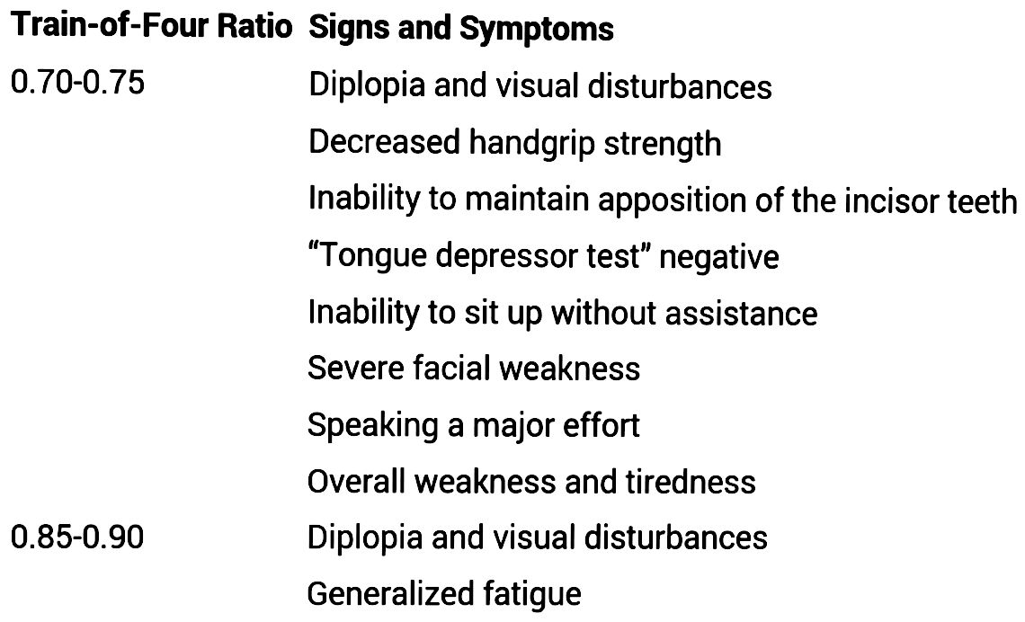

Slide 72
In clinical anesthesia, a TOF ratio of 0.70 to 0.75, or even 0.50, has been thought to reflect adequate recovery of neuromuscular function.
However, the TOF ratio, whether recorded mechanically or by EMG, must exceed 0.80 or even 0.90 to exclude clinically important residual neuromuscular blockade.
Moderate degrees of neuromuscular blockade decrease chemoreceptor sensitivity to hypoxia and thereby lead to insufficient response to a decrease in oxygen tension in blood.
Moreover, residual blockade (TOF < 0.90) is associated with functional impairment of the pharyngeal and upper esophageal muscles, which most probably predisposes to regurgitation and aspiration of gastric contents.

Slide 73
Accordingly, residual blockade (TOF < 0.70) caused by the long-acting muscle relaxant pancuronium is a significant risk factor for the development of postoperative pulmonary complications .
Even in volunteers without sedation or impaired consciousness, a TOF ratio of 0.9 or less may impair the ability to maintain the airway.
Adequate recovery of neuromuscular function requires return of an MMG or EMG TOF ratio to 0.90 or greater, which cannot be guaranteed without objective neuromuscular monitoring

Slide 74
Depolarizing Neuromuscular Blockade (Phase I and II Blocks)
PHASE I BLOCK
Patients with normal plasma cholinesterase activity who are given a moderate dose of succinylcholine (0.5 to 1.5 mg/kg) undergo a typical depolarizing neuromuscular block
The response to TOF or tetanic stimulation does not fade, and no post-tetanic facilitation of transmission occurs).
PHASE II BLOCK (DUAL, MIXED, OR DESENSITIZING BLOCK).
In contrast, some patients with genetically determined abnormal plasma cholinesterase activity who are given the same dose of succinylcholine undergo a nondepolarizing-like block characterized by fade in the response to TOF and tetanic stimulation and the occurrence of post-tetanic facilitation of transmission
In addition, phase II blocks sometimes occur in genetically normal patients after repetitive bolus doses or a prolonged infusion of succinylcholine.

Slide 75
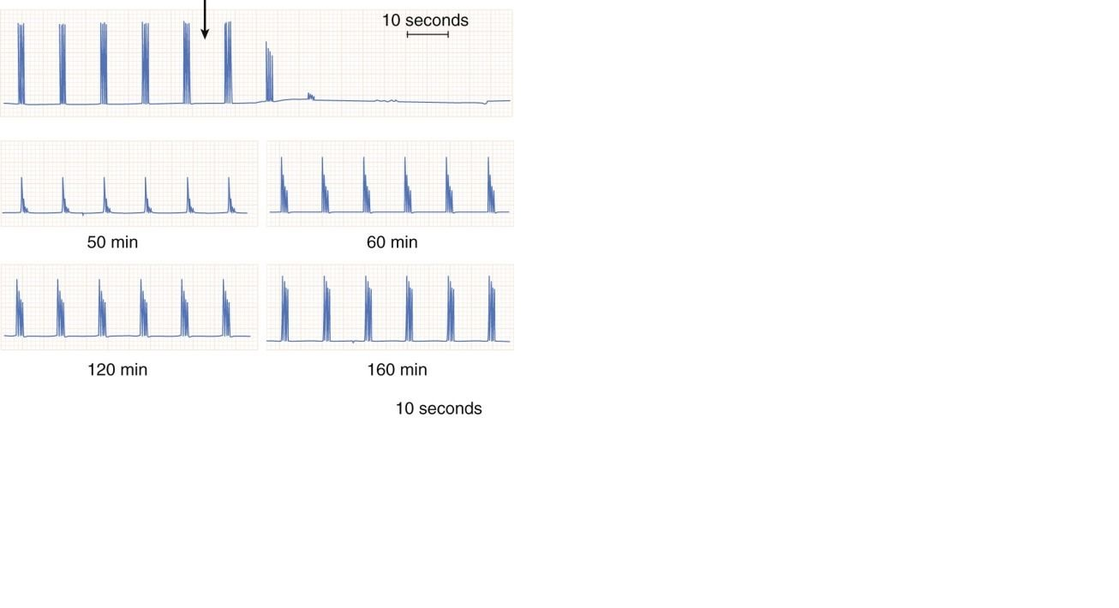
Typical recording of the mechanical response to train-of-four ulnar nerve stimulation after injection of 1 mg/kg of succinylcholine (arrow) in a patient with genetically determined abnormal plasma cholinesterase activity.
The prolonged duration of action and the pronounced fade in the response indicate a phase II block.

Slide 76
In normal patients, a phase II block can be antagonized by administering a cholinesterase inhibitor a few minutes after discontinuation of succinylcholine.
In patients with abnormal genotypes, however, the effect of intravenous injection of an acetylcholinesterase inhibitor (e.g., neostigmine) is unpredictable.
For example, neostigmine can
Potentiate the block dramatically,
Temporarily improve neuromuscular transmission, and then potentiate the block
Partially reverse the block,
All depending on the time elapsed since administration of succinylcholine and the dose of neostigmine given.
Therefore, unless the cholinesterase genotype is known to be normal, antagonism of a phase II block with a cholinesterase inhibitor should be undertaken with extreme caution. Even if neuromuscular function improves promptly, patient surveillance should continue for at least 1 hour.

Slide 77
Use of Nerve Stimulators Without Recording Equipment
First, for supramaximal stimulation, careful cleansing of the skin and proper placement and fixation of electrodes are essential.
Second, every effort should be taken to prevent central cooling, as well as cooling of the extremity being evaluated. Both central and local surface cooling of the adductor pollicis muscle may reduce twitch tension and the TOF ratio.
Peripheral cooling may affect
Nerve conduction,
Decrease the rate of release of acetylcholine and muscle contractility,
Increase skin impedance, and
Reduce blood flow to muscles, thus decreasing the rate of removal of muscle relaxant from the neuromuscular junction.

Slide 78
Third, when possible, the response to nerve stimulation should be evaluated by feel and not by eye, and the response of the thumb (rather than response of the fifth finger) should be evaluated.
Direct stimulation of the muscle often causes subtle movement of the fifth finger when no response is present at the thumb.
Finally, the different sensitivities of various muscle groups to neuromuscular blocking agents should always be kept in mind.

Slide 79
Use of a Peripheral Nerve Stimulator During Induction of Anesthesia
The nerve stimulator should be attached to the patient before induction of anesthesia but should not be turned on until after the patient is unconscious.
Single-twitch stimulation at 1 Hz may be used initially when seeking supramaximal stimulation.
However, after supramaximal stimulation has been ensured and before muscle relaxant is injected, the mode of stimulation should be changed to TOF (or 0.1-Hz twitch stimulation).
Then, after the response to this stimulation has been observed (the control response), the neuromuscular blocking agent is injected.
Although the trachea is often intubated when the response to TOF stimulation disappears, postponement of this procedure for 30 to 90 seconds, depending on the muscle relaxant used, usually produces better conditions.

Slide 80
Use of a Peripheral Nerve Stimulator During Surgery
If tracheal intubation is facilitated by the administration of succinylcholine, no more muscle relaxant should be given until the response to nerve stimulation reappears or the patient shows other signs of returning neuromuscular function.
If plasma cholinesterase activity is normal, the muscle response to TOF nerve stimulation reappears within 4 to 8 minutes.
When a nondepolarizing neuromuscular drug is used for tracheal intubation, a longer-lasting period of intense blockade usually follows.
During this period of no response to TOF and single-twitch stimulation, the time until return of response to TOF stimulation may be evaluated by PTC.

Slide 81
For most surgical procedures requiring muscle relaxation, twitch depression of approximately 90% will be sufficient, provided that the patient is adequately anesthetized.
If a nondepolarizing relaxant is used, one or two of the responses to TOF stimulation can be felt.
Because the respiratory muscles (including the diaphragm) are less sensitive to neuromuscular blocking agents than the peripheral muscles are, the patient may breathe, hiccup, or even cough at this depth of blockade.
To ensure paralysis of the diaphragm, neuromuscular blockade of the peripheral muscles must be so intense that the PTC is zero in the thumb.
An added advantage of keeping the neuromuscular blockade at a level of one or two responses to TOF stimulation is that antagonism of the block is facilitated at the end of surgery.

Slide 82
Use Of A Peripheral Nerve Stimulator During Reversal Of Neuromuscular Blockade
Antagonism of nondepolarizing neuromuscular blockade with a cholinesterase inhibitor such as neostigmine should probably not be initiated before at least two responses to TOF stimulation are present or before obvious clinical signs of returning neuromuscular function are seen.
Reversal of neuromuscular blockade will not be hastened and may possibly be delayed by giving neostigmine when no response to peripheral nerve stimulation is present.
Conversely, to achieve rapid reversal (within 10 minutes) to a TOF ratio of 0.7 in more than 90% of patients, three and preferably four responses should be present at the time of neostigmine injection.
During recovery of neuromuscular function, when all four responses to TOF stimulation can be felt, an estimation of the TOF ratio may be attempted.
Greater sensitivity is achieved with DBS_{3,3}, but even absence of manual fade in the DBS_{3,3} response does not exclude clinically significant residual blockade.

Slide 83
Clinical Tests of Postoperative Neuromuscular Recovery
Unreliable
Sustained eye opening
Protrusion of the tongue
Arm lift to the opposite shoulder
Normal tidal volume
Normal or nearly normal vital capacity
Maximum inspiratory pressure less than 40 to 50 cm H₂O
Most Reliable
Sustained head lift for 5 seconds
Sustained leg lift for 5 seconds
Sustained handgrip for 5 seconds
Sustained “tongue depressor test”
Maximum inspiratory pressure 40 to 50 cm H₂O or greater

Slide 84
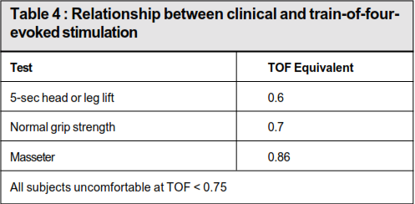

Slide 85
Tongue Depressor Test
Is a sensitive and useful bedside test to asses the adequate recovery of neuromuscular function.
At a TOF ratio of 0.70 most volunteers cannot retain a wooden tongue depressor between their incisor teeth against even minimal effort to remove it.
In general, full return of masseter strength does not occur until the TOF ratio exceeds 0.80.
The practical implication of this is that if at the end of a case it is difficult or impossible to remove a patient’s bite block, it is highly likely that adequate neuromuscular recovery has taken place.

Slide 86
When to Use a Peripheral Nerve Stimulator?
Good evidence-based practice dictates that clinicians should always quantitate the extent of neuromuscular recovery by objective monitoring.
At a minimum, the TOF ratio should be measured during recovery whenever a nondepolarizing neuromuscular block is not antagonized.

Slide 87
WHICH PATIENT SHOULD BE MONITORED?
By the foregoing discussion, it would seem prudent to monitor NMJ in all pts receiving NMBs.
Such monitoring is advisible particularly in conditions where the pharmacokinetics and pharmacodynamics of NMBs are altered significantly as listed below:
Several renal, liver disease
Neuromuscular disorders such as myasthenia gravis, myopathies , and upper and lower motor neuron lesions

Slide 88
Pts with severe pulmonary disease or marked obesity to ensure adequate recovery of skeletal muscle function.
Neuromuscular blockade achieved with continuous infusion of NMBs
Pts receiving long-acting NMBs
Pts undergoing lengthy surgical procedures

Slide 89
THANK YOU

Slide 90
REFERENCES
MILLER’S ANESTHESIA 8TH EDITION
CLINICAL ANESTHESIA BY PAUL G.BARASH 7TH EDITION
UNDERSTANDING ANESTHESIA EQUIPMENT 5TH EDITION – JERRY.A. AND SUSAN DORSCH
IJA-2002;46(4):279-288 MONITORING OF NMJ BY DR.D.PADMAJA DR.SRINIVAS MANTHA

